Slide 1
Performance testing
Focusing on elapsed time

Slide 2
Comparaison des performances, Step1 > Step6

Slide 3

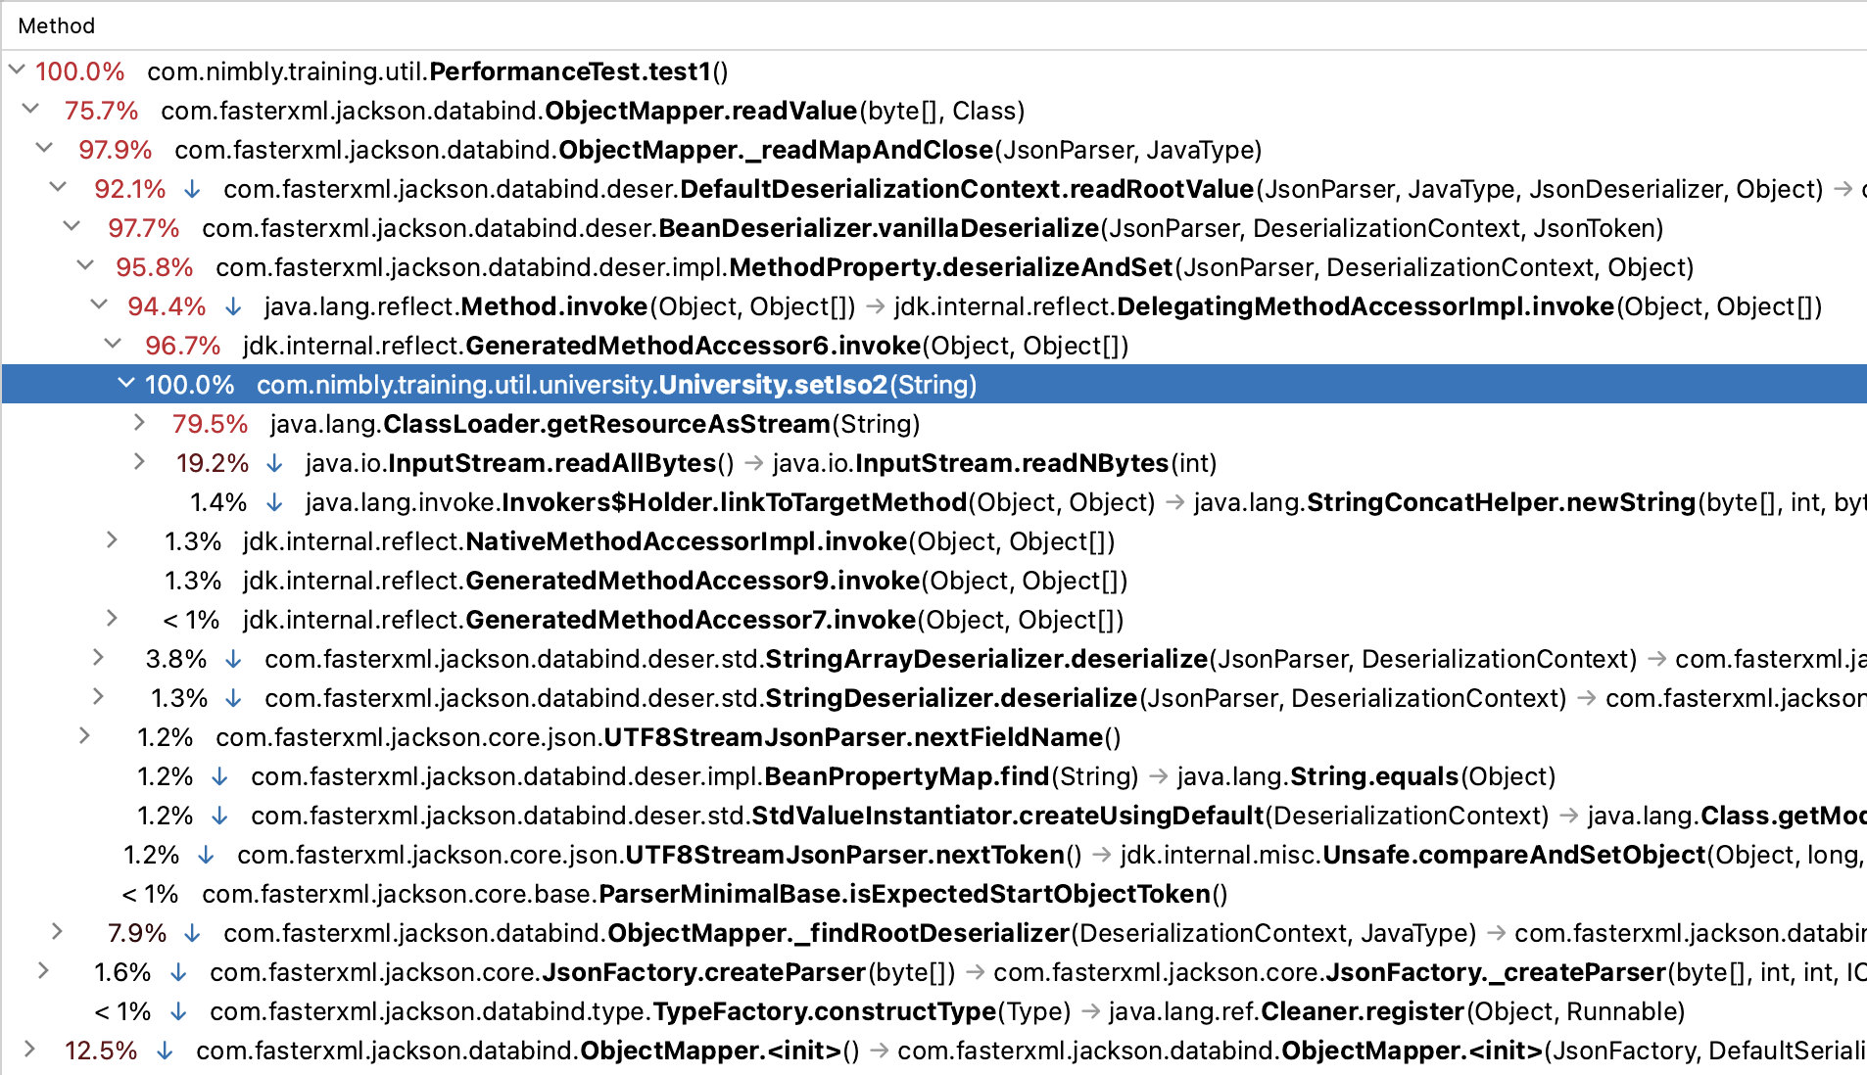
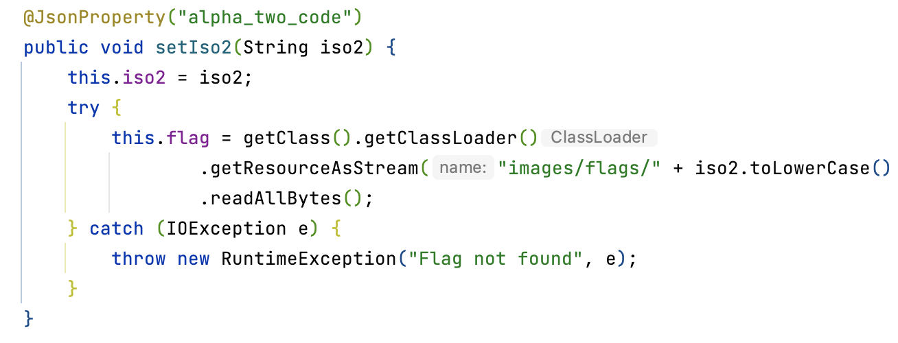
Step1

Slide 4



Step2

Slide 5


Step3

Slide 6


Step4

Slide 7



Step5

Slide 8


Step6

Slide 9
Performance testing
Focusing on memory

Slide 10
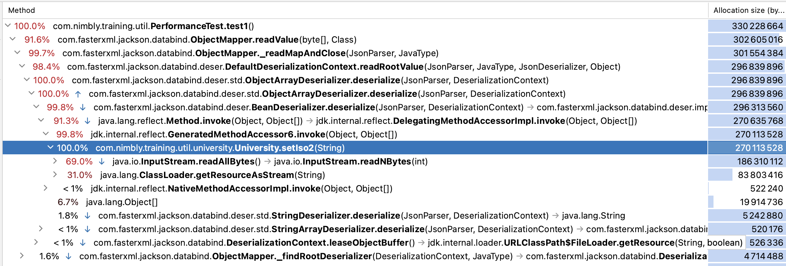
Step1

Slide 11

Step2

Slide 12

Step3

Slide 13

Step4

Slide 14
Step5

Slide 15
Step6

